Slide 1
We Chall
Enlightment
&
Simply Red

Slide 2
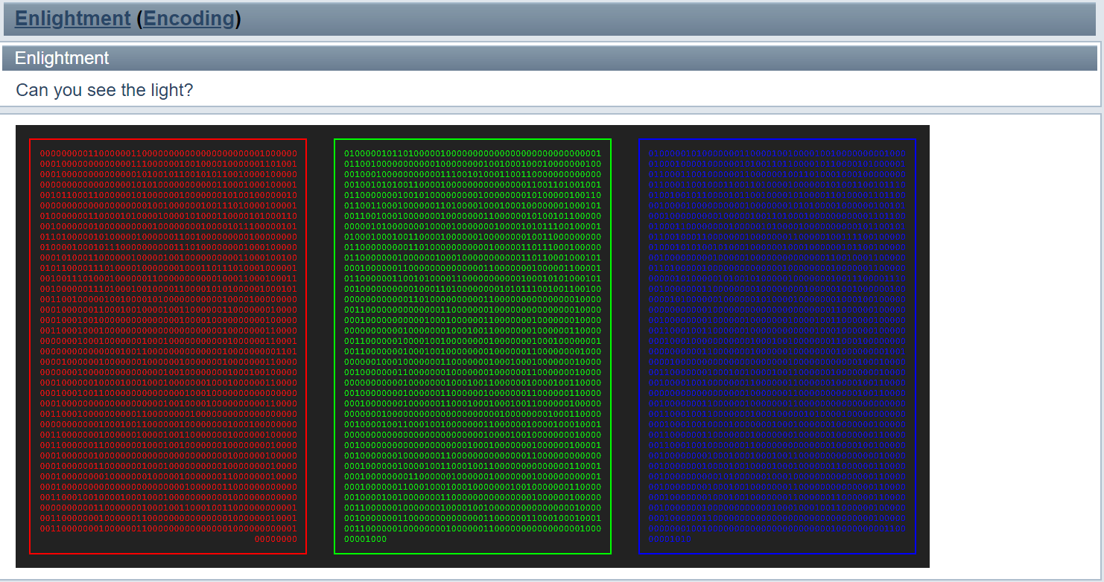
Notes:
光三原色

Slide 3


Slide 4
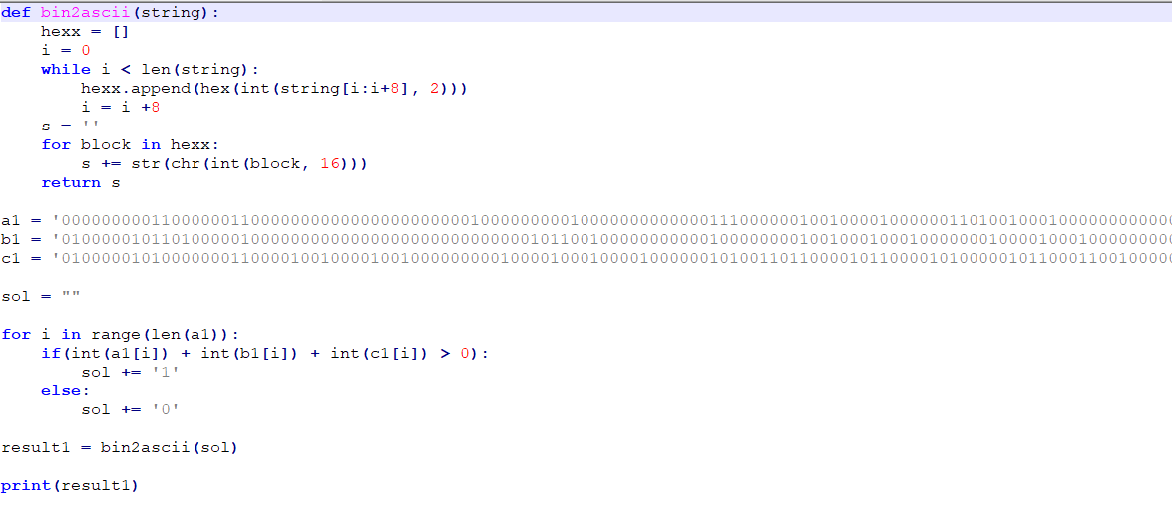
Notes:
a | b | c

Slide 5
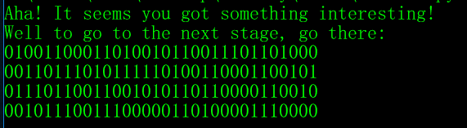
Ligh7_Level2.php

Slide 6
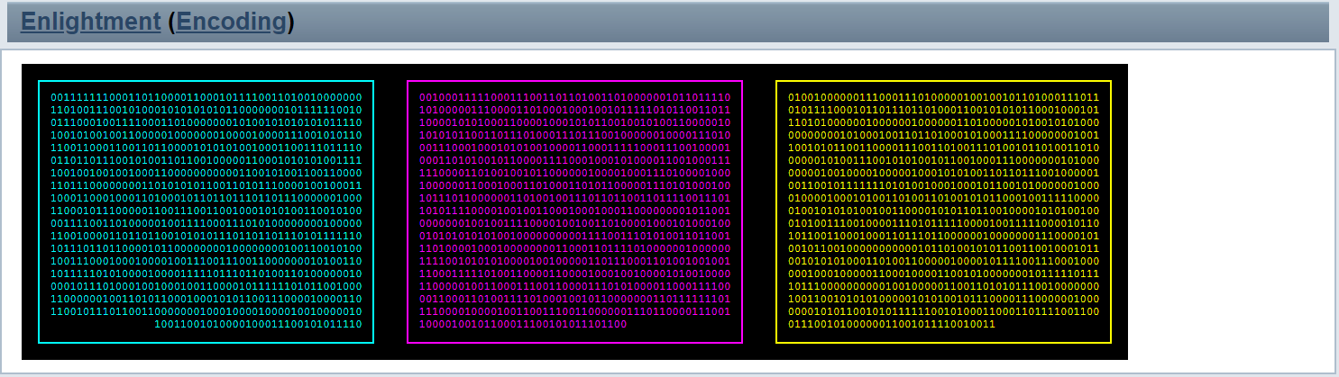
Notes:
顏料三原色

Slide 7


Slide 8
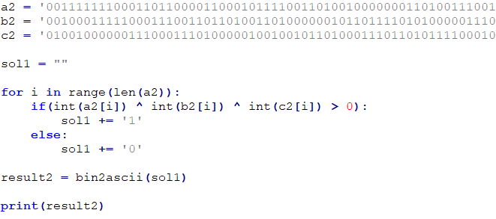
Notes:
a^b^c

Slide 9
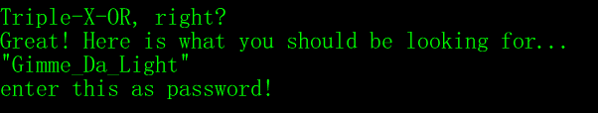

Slide 10
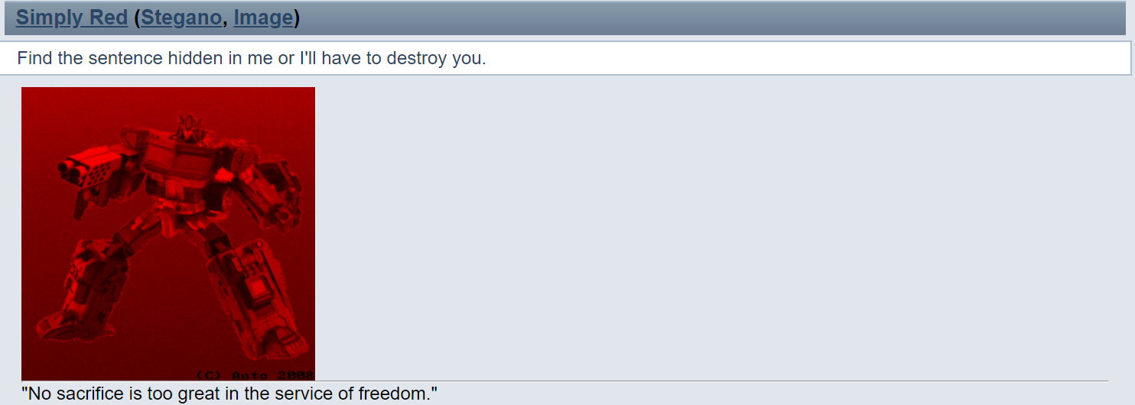

Slide 11
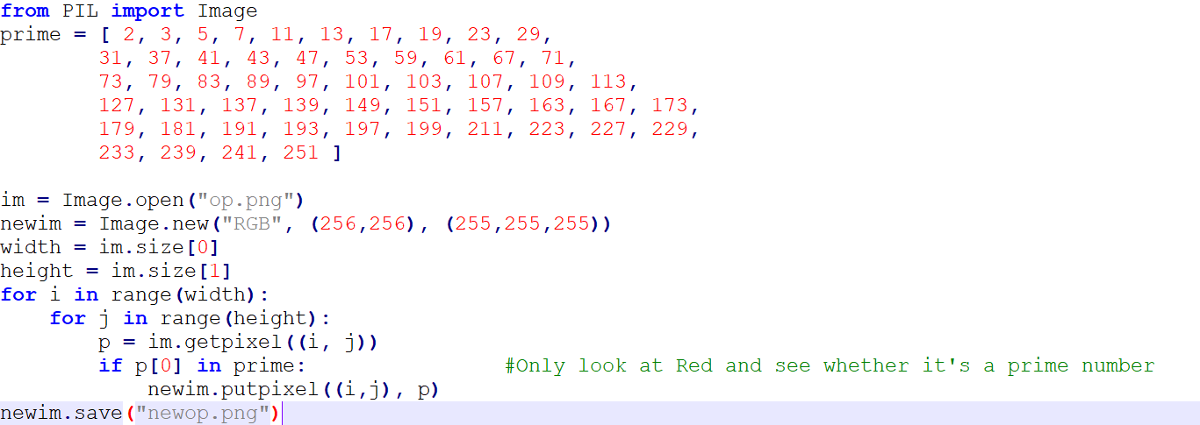
Notes:
Optimus Prime

Slide 12
